Slide 1
Chapter Twenty
Network Services, Cloud Computing, and Virtualization

Slide 2


220-902 Objectives Covered
2.2 Given a scenario, set up and use client-side virtualization.
  Purpose of virtual machines
  Resource requirements
  Emulator requirements
  Security requirements
  Network requirements
  Hypervisor
2.3 Identify basic cloud concepts.
  SaaS
  IaaS
  Paas
  Public vs. Private vs. Hybrid vs. Community
  Rapid Elasticity
  On-demand
  Resource pooling
  Measured service
2.4 Summarize the properties and purpose of services provided by networked hosts.
  Server roles
    Web server
    File server
    Print server
    DHCP server
    DNS server
    Proxy server
    Mail server
    Authentication server
  Internet appliance
    UTM
    IDS
    IPS
  Legacy / embedded systems
Notes:
Check font sizing.

Slide 3
Basic Server Roles
Dedicated/non-dedicated
Web server
File server
Print server
Notes:
Servers are generally named for the type of service they provide, such as a web server
or a print server.
They help improve network security and ease administration by centralizing
control of resources and security; without servers, every user would need to manage their own security and resource sharing.
Dedicated servers - dedicated to a specific task, such as hosting websites.
Nondedicated servers may perform multiple tasks
Web Server
Whenever you visit a web page, you are making a connection from your device (the
client) to a web server
The web server itself is configured with web hosting software, which listens for
inbound requests on port 80 (http) and/or port 443 (https)
Webservers are usually placed on the DMZ – Here the firewall is configured to allow inbound port 80 and 443 requests to the DMZ but not to allow inbound requests on those ports to make it to the internal corporate network.
File Server
Provides a central repository for users to store, manage, and access files on the network
Advantages – Ease of access, Centralized Security, Centralized Backup
Network attached storage (NAS) devices, which are stand-alone units that contain
hard drives, come with their own file management software, and connect directly to the
network.
Storage area network (SAN) is basically a network segment, or collection of servers, that exists solely to store and manage data. For large organizations
Print Server
A print server makes printers available to clients over the network and
accepts print requests from those clients

Slide 4
More Server Roles
DHCP server
DNS server
Proxy server
Mail server
Authentication server
Notes:
DHCP Servers
DHCP servers are configured to provide IP configuration information automatically to clients, such as an IP address, subnet mask, default gateway, and the address of a DNS server
DHCP scope, which contains the information that the server can provide to clients such as:
Address Pool - This is the range of addresses that the server can give out to clients
Lease Duration – How long the IP address is allocated to a client. Before the lease expires, the client (if it’s online) will typically renegotiate to receive a new lease
Address Reservation – For devices that need to have static (non-changing) IP addresses, the DHCP server can reserve those IP’s based on their MAC address to prevent them from being issued to other hosts
Scope options - Include extra configurations outside of IP such as router information and DNS servers
DNS Server
DNS has one function on the network, and that is to resolve hostnames to IP addresses
Such as http://www.google.com/ to 72.14.205.104
DNS works the same way on an intranet (a local network not attached to the Internet) as it does on the Internet – resolving computer names to IP addresses
Companies hosting a website require 2 public DNS (2 for redundancy)
Each DNS server has a database, called a zone file, which maintains records of hostname
to IP address mappings.
Proxy Server
A proxy server makes requests for resources on behalf of a client – Ex 20.1 Using Proxy
Mail Server
A mail server, runs an email server package. The most popular ones are Microsoft Exchange, sendmail, Postfix, and Exim, although there are dozens of others on the market
Email servers are most often located in the DMZ with these ports configured:
SMPT(25) – send email
POP3 (110) – Receives email
IMAP4 (143) – Receives email (newer than POP3)
Authentication Server
An authentication server is a device that examines the credentials of anyone trying to
access the network, and it determines if network access is granted
Such as domain controller, which is a centralized authentication server, RAS, Remote
Authentication Dial-in User Service (RADIUS), Terminal Access Controller Access-
Control System Plus (TACACS+), and Kerberos.

Slide 5
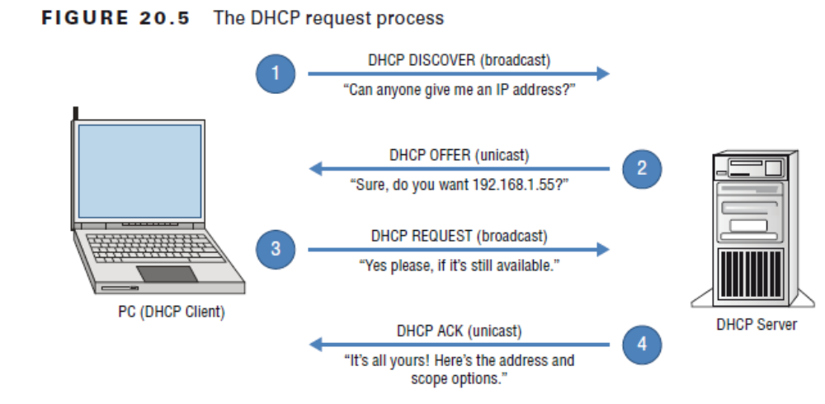
How DHCP Works

Slide 6
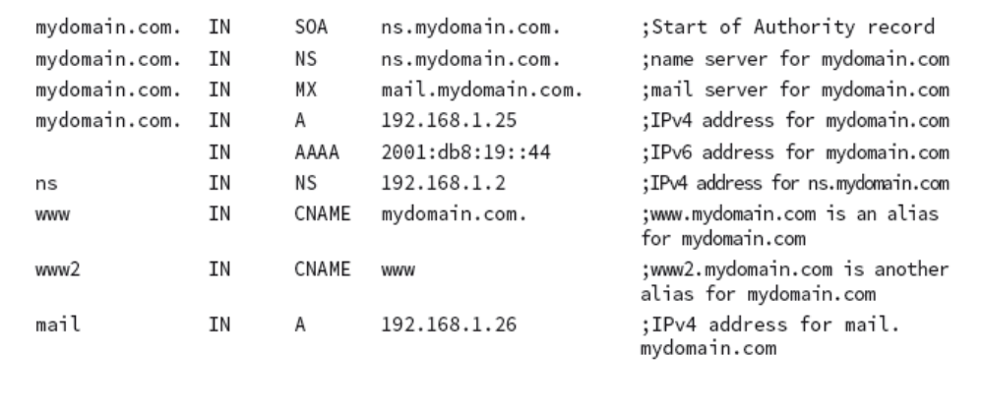
Sample DNS Zone File
Notes:
There are five columns of information presented. From left to right, they are as follows:
■■ The name of the server or computer, for example www.
■■ IN, which means Internet. (There are other options for this field, but for our purposes
we will focus on Internet.)
■■ The record type. This example has SOA, NS, MX, A, AAAA, and CNAME. See next Slide
■■ The address of the computer.
■■ Comments, preceded by a semicolon. In a file like this, the computer disregards everything
after a semicolon. It’s used to make notes for the administrator without affecting
functionality.

Slide 7
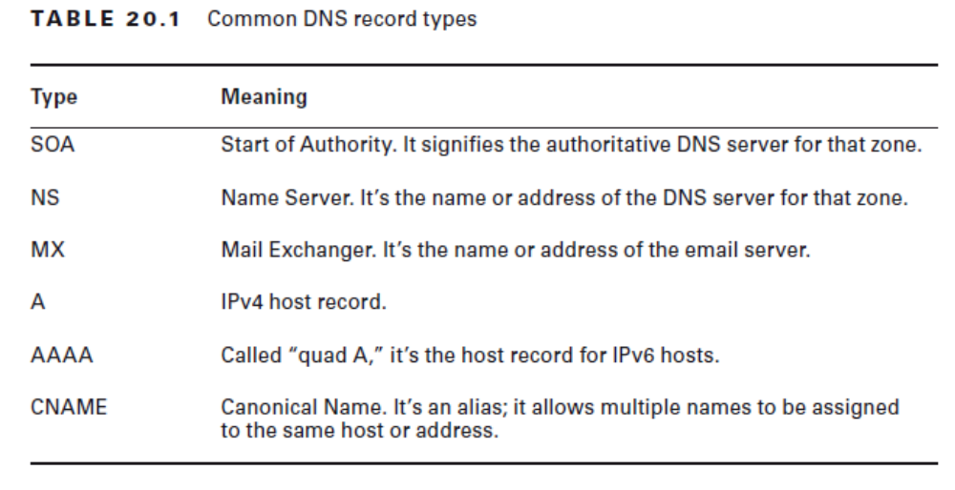
DNS Record Types

Slide 8
DNS on the Internet
You type www.sybex.com:
PC checks its zone file
Then checks its cache to see if the record is in there
It queries the Root Server
This process continues until the name is resolved
Notes:
PC check its zone file to see if it knows the IP address
Cache is a temporary database of recently resolved names and IP addresses
Sample zone file shows a trailing dot after each domain such as www.mydomain.com. The dot is the broadcast category known as “root” – Internet naming is hierarchical – see Figure 20.8. There are 13 global Root servers (http://www.iana.org/domains/root/servers)
***This explain why, if you visit a website you’ve never visited before, it can
sometimes take longer than normal to load (provided no one else who uses your DNS server
has visited the site recently either**

Slide 9
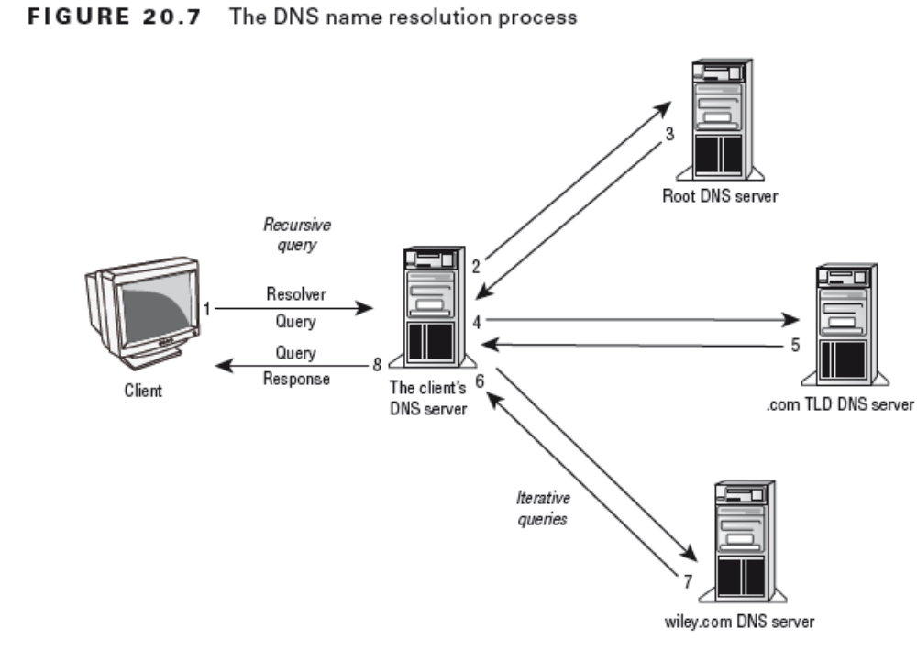

Slide 10
Internet Appliances
Intrusion Detection and Intrusion Protection Systems
Unified Threat Management
Notes:
The definition of an Internet appliance is a device that makes it easy to access the Internet
Intrusion Detection and Intrusion Protection Systems (IDS and IPS)
Both devices monitor network traffic and look for suspicious activity
IDSs and IPSs look for signatures of malicious contents just like Anti-viruses do, but in network traffic patterns.
Their primary function is to block malicious traffic from entering the network
An IDS is a passive device. It watches network traffic, detect anomalies, log the anomaly and send an alert to an administrator. It does nothing to prevent the attack; it simply logs relevant information pertaining to the attack and sends an alert
IPS is an active device. It too monitors network traffic, but when it detects an anomaly, it can take actions to attempt to stop the attack. For example, if it senses suspicious inbound traffic on a specific IP port, it can shut the port
Both can come as Host based (HIDS/HIPS) or Network based (NIDS/NIPS)
The network-based versions are designed to protect multiple systems, whereas the host-based ones protect only one computer.
Unified Threat Management (UTM)
The goal of unified threat management (UTM) is to centralize security management,
allowing administrators to manage all of their security-related hardware and software
through a single device or interface.
UTM is generally implemented as a stand-alone device (or series of devices) on a network, and it will replace the traditional firewall. A UTM device can generally provide the following types of services:
■■ Packet filtering and inspection, like a firewall
■■ Intrusion protection service
■■ Gateway anti-malware
■■ Spam blocking
■■ Malicious website blocking (either prohibited or nefarious content)
■■ Application control

Slide 11
Legacy and Embedded Systems
Hardware
Software (applications or OS)
Network protocols
Notes:
Legacy systems are usually defined as those using old technology in one or more of the above areas
Many legacy systems were state of the art when they were originally implemented in the 1970s or 1980s, but they haven’t been upgraded or replaced
Reasons for keeping legacy systems:
Companies that don’t have large IT budgets, find replacing legacy systems to be very expensive.
Cost of failure of an upgrade could be catastrophic. The world’s global financial systems are in many places supported by legacy systems. Messing up a migration in that context could be a career-limiting move
Time – to test, verify functionality, implement could be extensive

Slide 12
Cloud Services
Infrastructure as a Service (IAAS)
Platform as a Service (Paas)
Software as a Service (SaaS)
Notes:
Cloud computing is a method by which you access remote servers to store files or run
applications for you - Microsoft, Google, HP, Apple, Netflix, and Amazon
Cloud computing involves a concept called virtualization, which means that there isn’t necessarily a one-to-one relationship between a physical server and a logical (or virtual) server. In other words, there might be one physical server that virtually hosts cloud servers for a dozen companies, or there might be several physical servers working together as one logical server
infrastructure as a service (IaaS), is a lot like paying for utilities—the client pays for what it uses and includes typically networking infrastructure services like networking services
Platform as a service (PaaS) adds a layer to IaaS that includes software development tools such as runtime environments
software as a service (SaaS), which handles the task of managing software and its deployment, and it includes the platform and infrastructure as well – Google Docs, Dropbox, Office 365

Slide 13
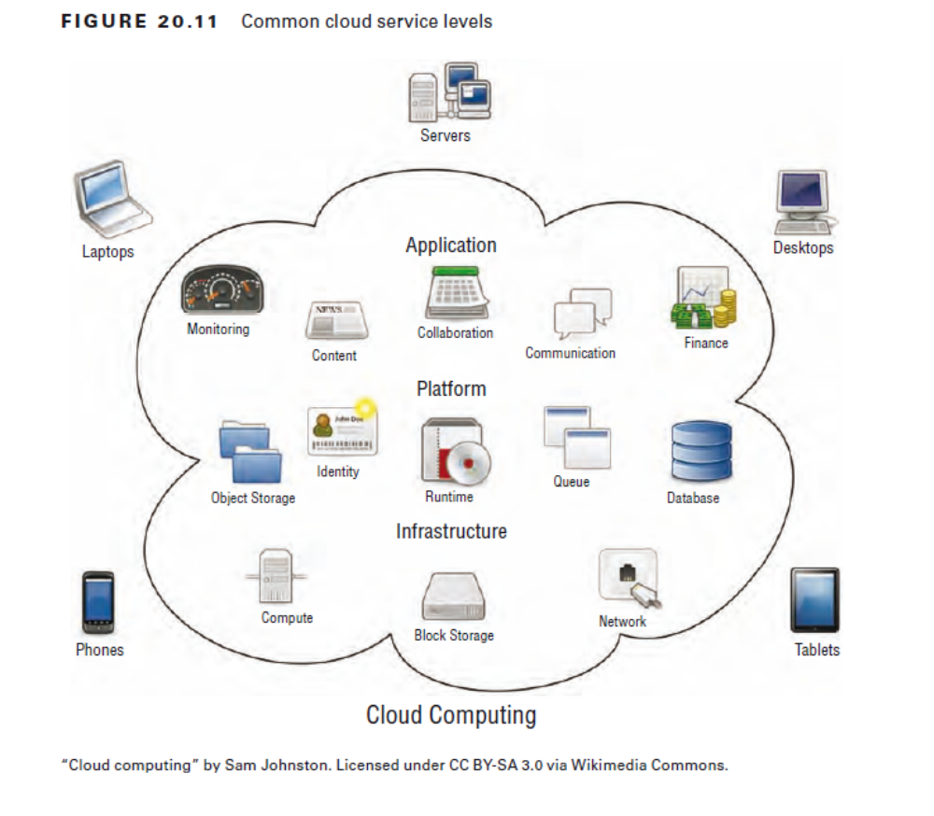

Slide 14
Types of Clouds
Private
Public
Hybrid
Community
Notes:
private cloud - individual clouds within their own network; allows the company to control its own security
public cloud - are operated by the third-party companies; offer the best in scalability, reliability, flexibility, geographical independence, and cost effectiveness
hybrid cloud - combine public and private clouds; to get the best of both worlds.
community cloud - are created when multiple organizations with common interests combine to create a cloud. In a sense, it’s like a public cloud with better security

Slide 15
Cloud Features
On-demand self-service
Broad network access
Resource pooling
Rapid elasticity
Measured service
Notes:
on-demand self-service, users can access additional storage, processing,
and capabilities automatically, without requiring intervention from the service
provider.
Broad network access aka Ubiquitous access - The ability for users to get the data they want, when they want, how they want – using workstations, laptops, and mobile phones.
Resource pooling - The provider’s resources are seen as one large pool, which can be divided up among clients as needed – bandwidth, storage, memory etc
Rapid elasticity – Ability to scale up resources as needed but instantly or rapidly - pay-as-you-grow Services
Measured Service – Clients’ usage is metered/measured before they’re charged for the services used

Slide 16
Using Cloud Services
Cloud Based Storage
Cloud Based Applications
Notes:
Storage
The idea is simple—users store files just as they would on a hard drive but with two major advantages. One, they don’t need to buy the hardware.
Two, different users can access the files regardless of where they are physically located.
Applications
Chromebook Platform was built on this premise – all applications run from the web
Microsoft Office 365, Google Docs
Ex 20.2 Using Google Cloud

Slide 17
Virtualization
Virtual Machines
Hypervisor
Notes:
The term virtualization is defined as creating virtual (rather than actual) versions of something
Virtualization is often used to let multiple OSs (or multiple instances of the same OS) run
on one physical machine at the same time
VM
The virtualized version of a computer is appropriately called a virtual machine (VM)
The underlying purpose of all of this is to save money
Virtual OSs can be powered on or off individually without affecting the
host OS or hypervisor
Hypervisor
The key enabler for virtualization is a piece of software called the hypervisor, also known
as a virtual machine manager (VMM
The hypervisor software allows multiple operating systems to share the same host, and it also manages the physical resource allocation to those virtual OSs

Slide 18
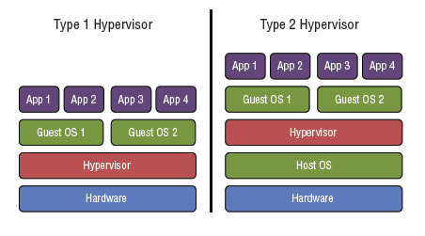
Types of Hypervisors
Notes:
A Type 1 hypervisor sits directly on the hardware, and because of this, it’s sometimes
referred to as a bare metal hypervisor. In this instance, the hypervisor is basically the operating system for the physical machine. This setup is most commonly used for server-side virtualization, because the hypervisor itself typically has very low hardware requirements to support its own functions.
Type 1 is dedicated i.e. no host OS present and therefore has better performance
A Type 2 hypervisor sits on top of an existing operating system, called the host OS. This
is most commonly used in client-side virtualization, where multiple OSs are managed on
the client machine as opposed to on a server

Slide 19
Client-Side Virtualization
Resource requirements
Emulator requirements
Security requirements
Notes:
Resource Requirements
Resources shared: CPU, RAM, hard drive space, and network performance
CPU: the hypervisor can treat each core of a processor as separate
virtual processors, and it can even create multiple virtual processors out of a single
Core. Some hypervisors require that the CPU be specifically designed to support virtualization.
For Intel chips, this technology is called virtualization technology (VT), and AMD
chips need to support AMD-V
RAM – Allocated when creating the VM and can be modified later
Hard disk space works the same way as RAM. Each OS will need its own hard disk
Space
The VM will create a virtual NIC and manage the resources of that NIC appropriately

Slide 20
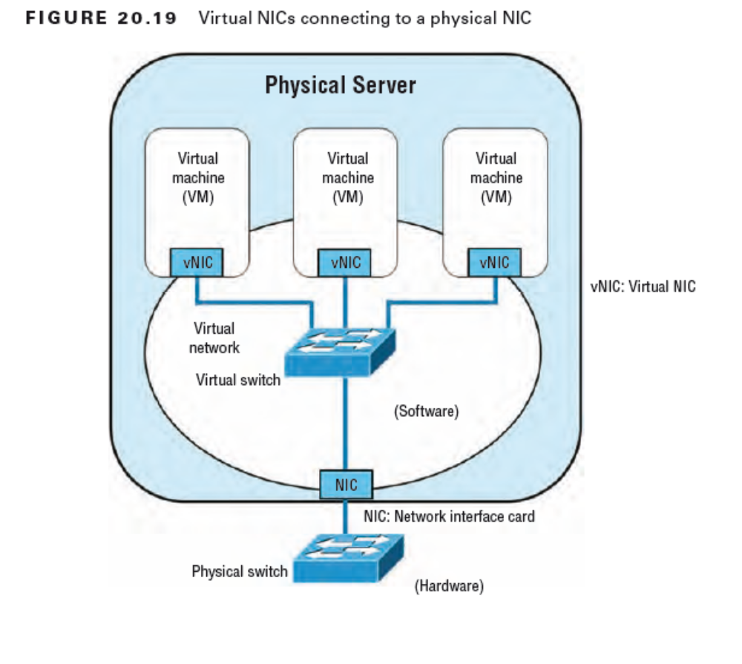

Slide 21
Client-Side Virtualization
Resource requirements
Emulator requirements
Security requirements
Notes:
Emulator Requirements
All of the requirements that a physical machine would have need to be replicated by
the hypervisor, and that process is called emulation.
The terms hypervisor and emulator often get used interchangeably, although they don’t mean the same thing. The hypervisor can support multiple OSs, whereas technically, an emulator appears to work the same as one specific OS.
Security Requirements
Instead of attacking the OS in the VM, hackers have turned their attention to attacking the hypervisor itself
The solution to most virtual machine threats is to always apply the most recent updates to keep the system(s) current

